Slide 1
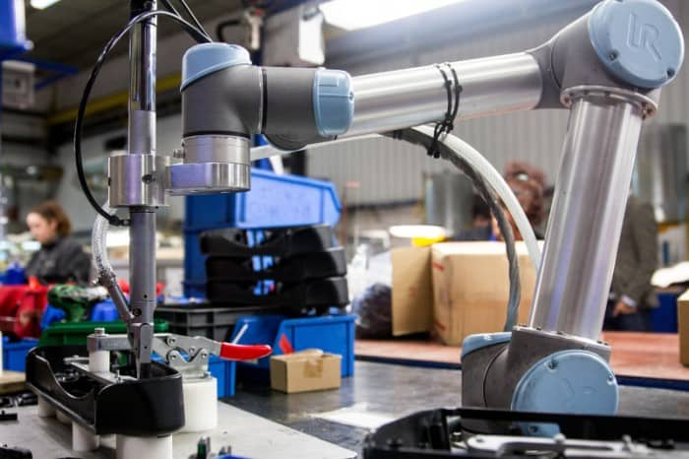

CSC485B Machine Learning for Robotics
SUNY Plattsburgh
Dr. Ned Lecky
Class 12- More Techniques And Examples

Slide 2
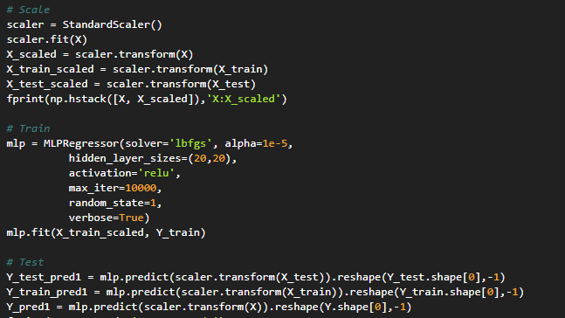
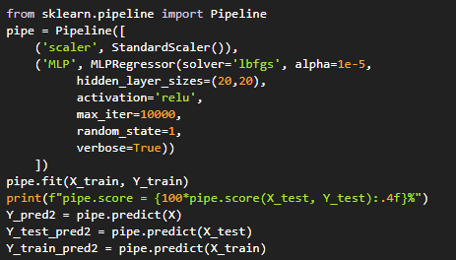
Basic Pipeline
Using a Pipeline (Pythagoras Example)
https://github.com/nedlecky/CSC485B/blob/main/CSC485_140_PythagorasPipeline.ipynb
A bunch easier and keeps us from forgetting to scale

Slide 3
How About Custom Pipeline Steps?
I started writing an example, but then discovered something twice as detailed as what I was working on!
https://towardsdatascience.com/pipelines-custom-transformers-in-scikit-learn-the-step-by-step-guide-with-python-code-4a7d9b068156
Let’s walk through the Himanshu Chandra’s Colab
So much good stuff in here!
Using Pandas data frames throughout so you can index by name
Some alternative coding strategies
Great to look at and pick up ideas from

Slide 4

Iris Dataset Walkthroughs
Some other code ideas that will help with your work
With a Classifier
https://github.com/nedlecky/CSC485B/blob/main/CSC485_210_IrisClassifierStudy.ipynb
With Clustering
https://github.com/nedlecky/CSC485B/blob/main/CSC485_220_IrisClusterStudy.ipynb

Slide 5
Random Blob Walkthrough
Synthesize random positions
https://github.com/nedlecky/CSC485B/blob/main/CSC485_225_BlobClusterStudy.ipynb

Slide 6
Next Assignment: Reminder
Build your own real-world classification problem
Invent a (simple) problem
Generate synthetic data (or acquire something real)
Try different classifiers and adjust your data and approach until you are successful
Build your own real-world clustering problem
Invent a (simple) problem
Generate synthetic data (or acquire something real)
Try different clustering algorithms and adjust your data and approach until you are successful

Slide 7
Idea Brainstorm
Something to think about over break
Where do you see datasets that you could use ML tools on?
Regression
Classification
Clustering
Remember my pie chart and try to pick something that you believe can work

